Slide 1
Orange SMART Approach
Preliminary Noise Findings
Trial Period: Oct-2020 to Apr-2021

Slide 2
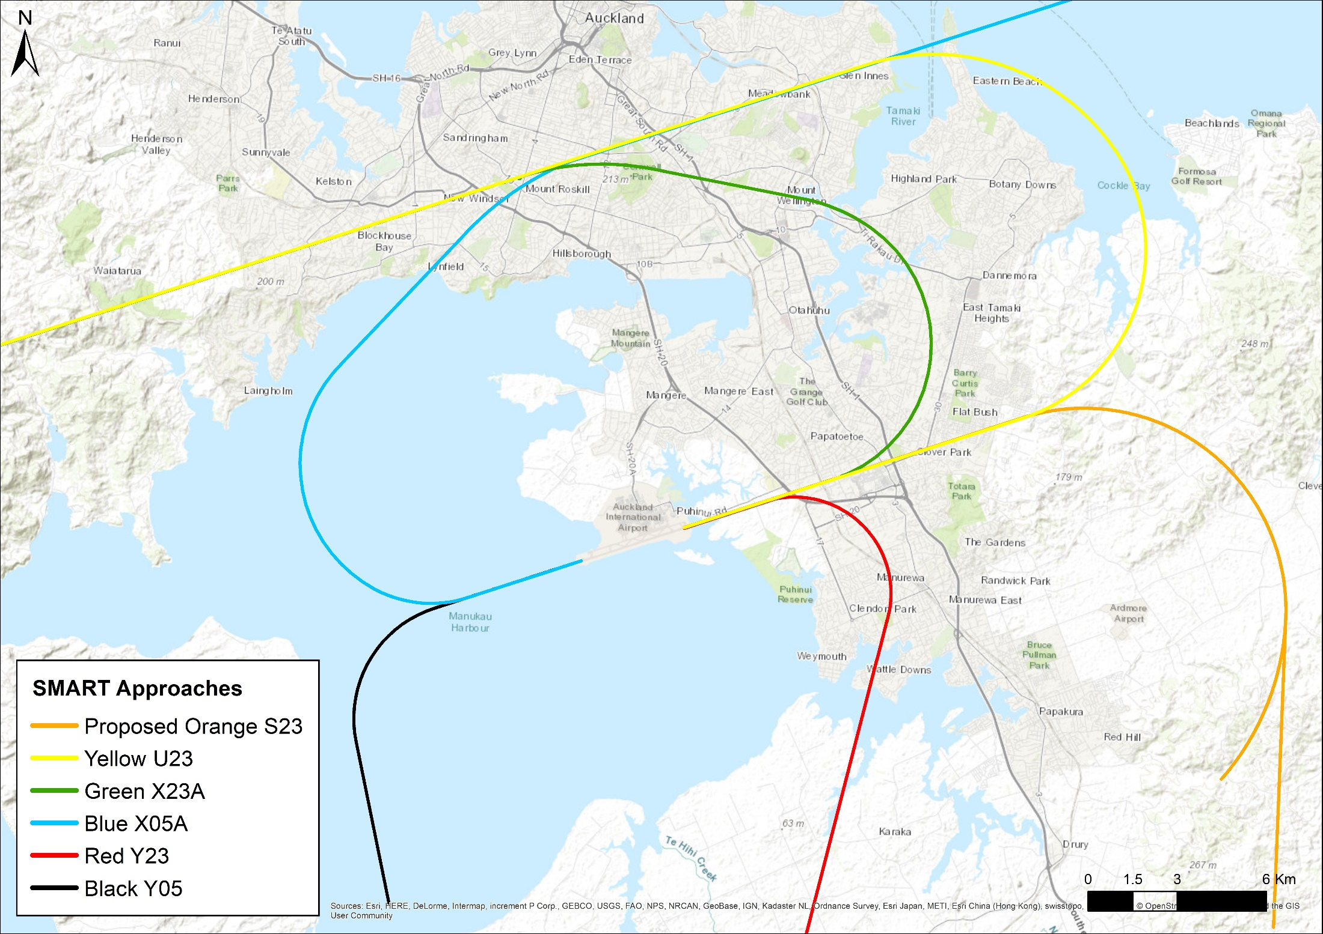
Figure 6: Location of SMART Approaches
Clevedon monitor
Notes:
Figure 6 shows the location of the SMART approach flight paths.

Slide 3
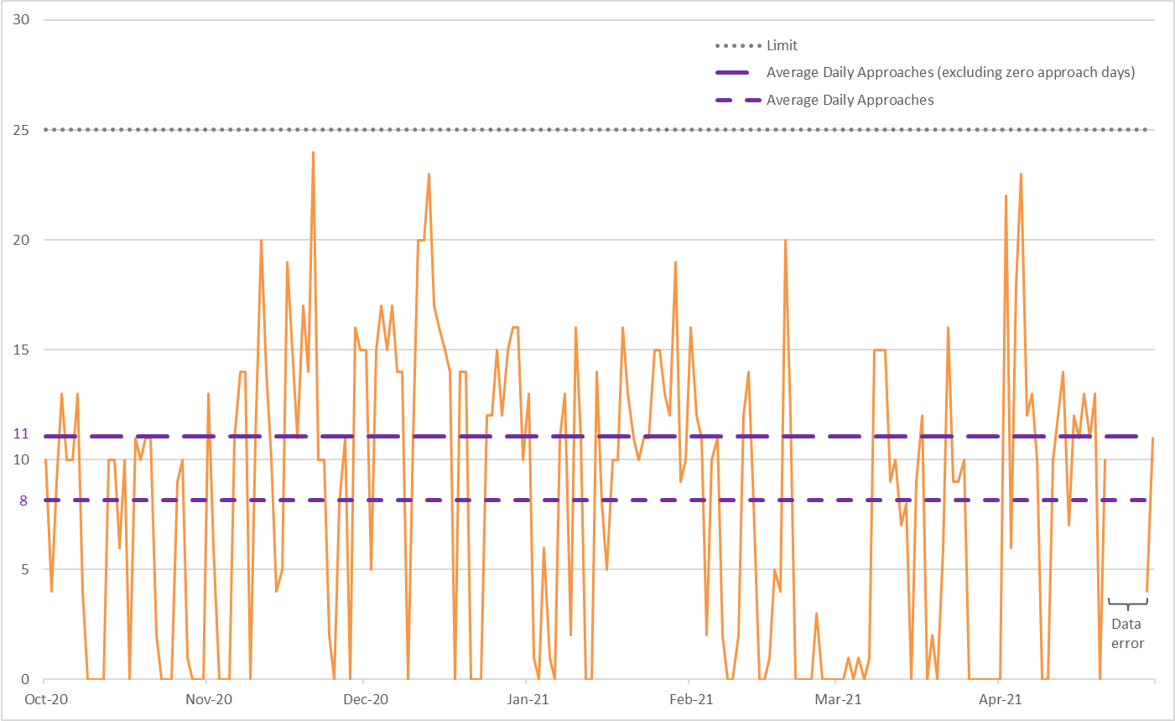
Figure 1: Number of Orange S23 approaches per day during trial

Slide 4
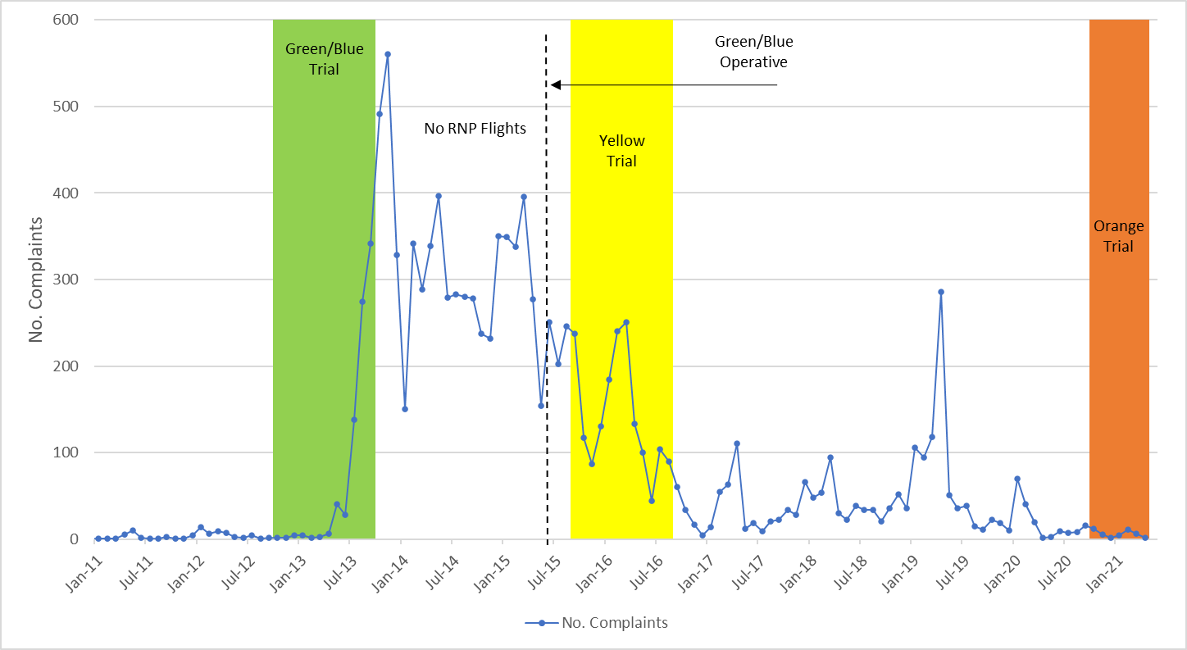
Figure 2: Historical complaints trends
Spike due to complaints from one person within ANNA

Slide 5
Table 1: Summary of overall complaints during the trial periods
Total Complaints | Specific Complaints | Generic Complaints | Complainants
42 | 27 | 10 | 17
Table 2: Summary of specific complaints made during the trial periods
23L / 05R / Other | Landing / Take-off / Other | Jet / Other
33% / 37% / 30% | 52% / 19% / 29% | 67% / 33%
Table 3: Number of specific complaints made during the trial periods
Overall Number of Specific Complaints | 27
Number of Orange Complaints | 0
Number of Orange Approaches | 1,669
Number of Orange Complainants | 0

Slide 6
Table 4: Average L_{Amax} level of an individual aircraft overflight at Clevedon
No. of Events Orange / non-SMART | Average L_{Amax} Orange | Average L_{Amax} non-SMART | Difference
987 / 178 | 60.9 dB | 61.6 dB | -0.6
NB: Events analysed were arrivals on RWY23, picked up by the Clevedon monitor. The Orange flights were identified using a gate analysis, with the remaining flights being non-SMART.
Table 5: Calculated L_{dn} level at Clevedon for varying Orange approaches per day
1 per day | 11 per day | 24 per day | 30 per day | 40 per day
23.4 dB | 33.8 dB | 37.2 dB | 38.2 dB | 39.4 dB
NB: New Zealand Standard NZS 6805 states that areas exposed to levels below 55 dB L_{dn} are suitable for residential development

